Slide 1
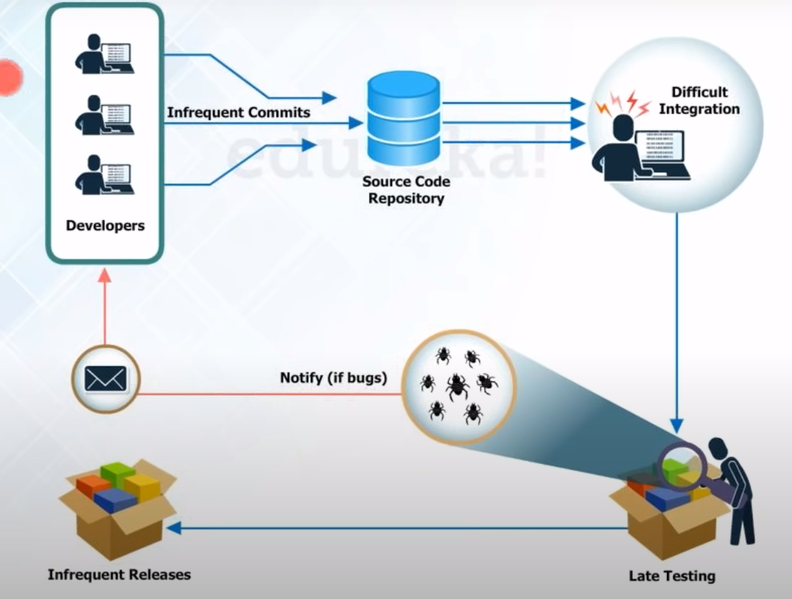
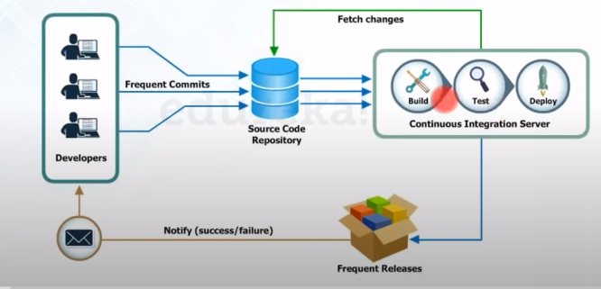
Before and after continuous Integration

Slide 2
Why continuous Integration?
Team Side
Developers have to wait till the complete software is developed for test results.
If a particular test fails, then locating and fixing bugs become very difficult. Developers has to rework the entire source code to correct the issue.
Business Side
Software delivery process was slow

Slide 3
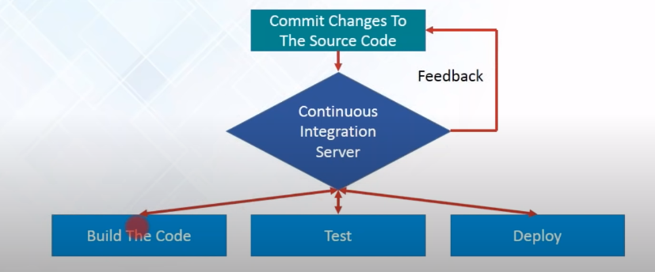
Work - Flow

Slide 4
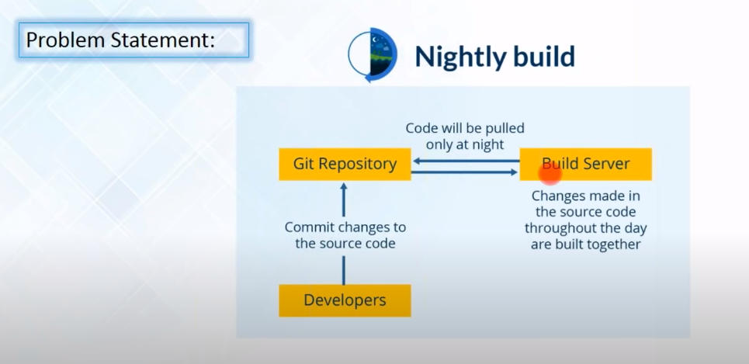
Case study – Nightly build

Slide 5
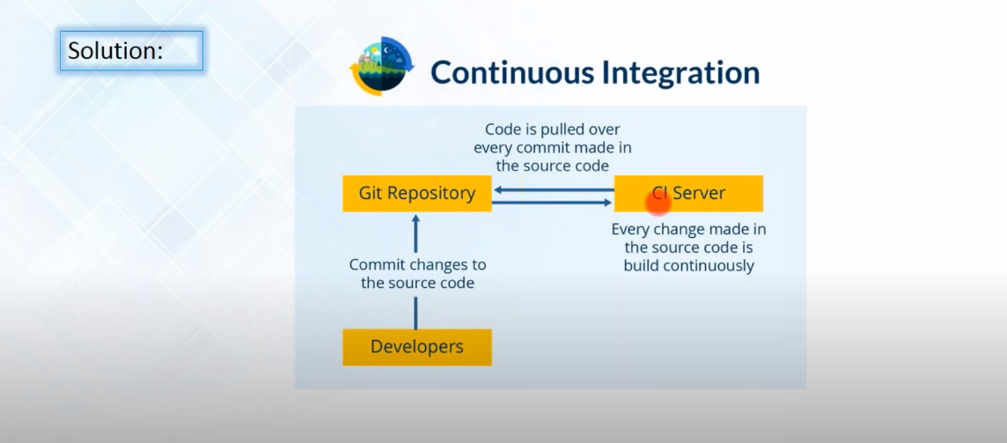
Case study – Nightly build

Slide 6
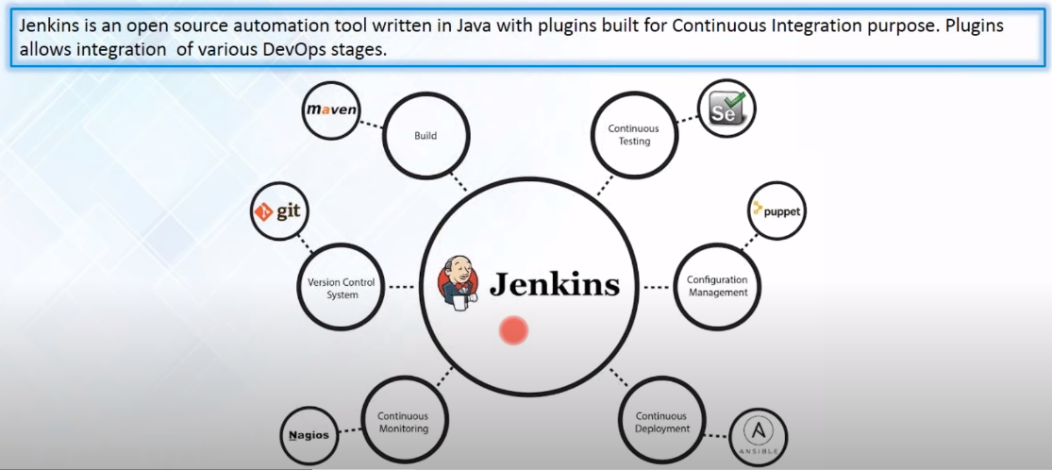
What is Jenkins ?

Slide 7
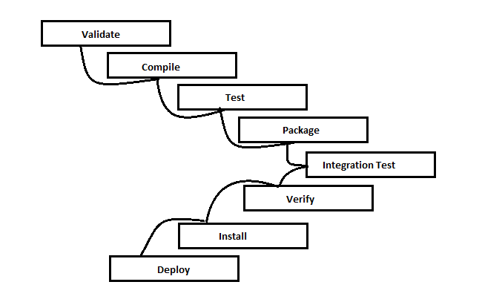
Maven Build Lifecycle

Slide 8
Testing Phase by Maven
Warnings , new warnings and fixed warnings
High Priority, Low Priority and Normal Priority
Types – Empty Catch Block, Finally block, Try block, useless parenthesis, unused variables
Warnings- line number, package, class name etc.

Slide 9
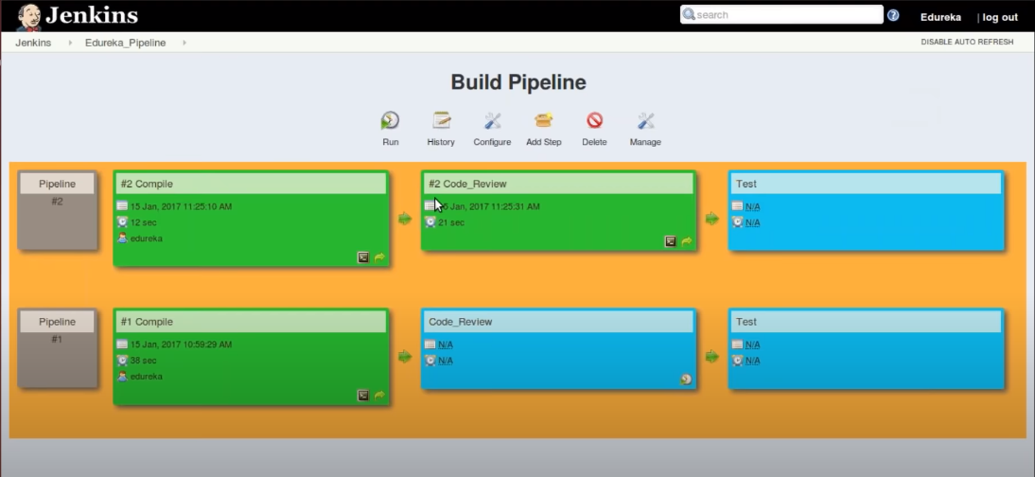

Slide 10
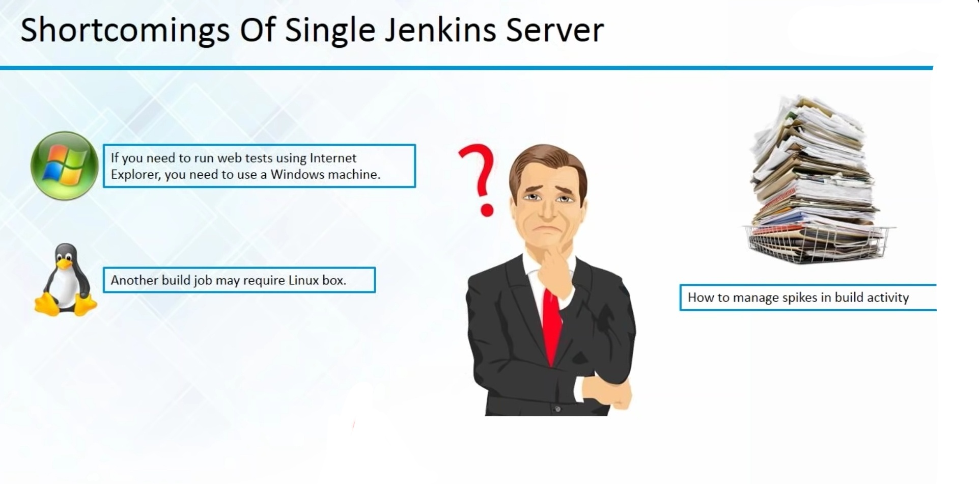

Slide 11
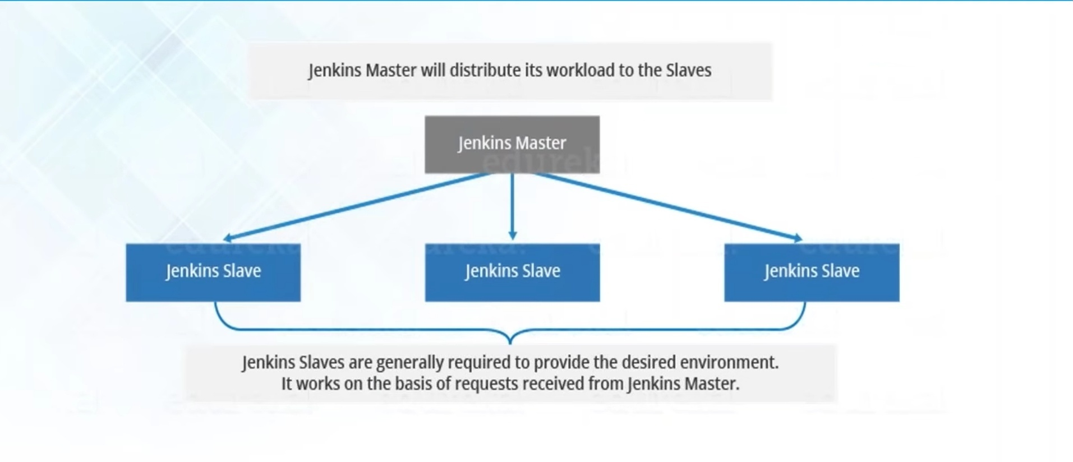
Jenkins Distributed Architecture

